Slide 1
Context-Based Music Composition using RNN generative model
Apurva Pathak
Kshitiz gupta
Chaitanya Baratam
Ritvik Jaiswal
Puneeth Bommireddy

Slide 2
Outline
Introduction
Motivation
Dataset and Representation
Learning Model
Results
Feature Visualization
Demo
Summary

Slide 3
Introduction
Music generation based on input context
One-hot encoded auxiliary input.
Ex: French (1,0,0), Irish (0,1,0), Swedish (0,0,1)
Character-level RNN generative model
2-Layered LSTM networks
Dropout and gradient clipping

Slide 4
Motivation
“Capturing Meaning in Product Reviews with Character-Level Generative Text Models”- Lipton, Vikram, McAuley, (2015).
RNN to generate reviews tailored to star rating or category.
Generated reviews one character at a time.
Weight transplant to speed-up the learning rate.
“A first look at music composition using lstm recurrent neural networks”- Eck, Douglas., (2002)
LSTM based model for music composition.

Slide 5
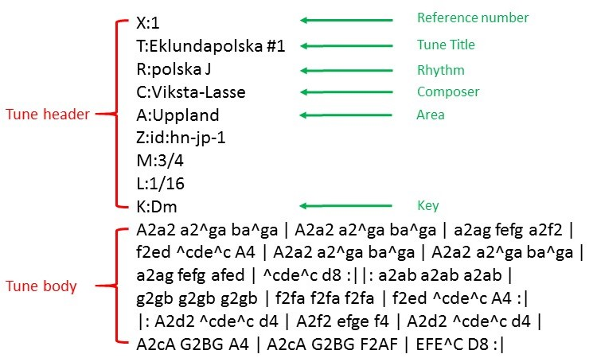
Dataset and Representation
Scraped music files from “Henrik Norbeck’s Abc Tunes” and “Musique Abc Tunes”
2180 Irish tunes, 388 Swedish tunes and 553 French tunes
Tunes represented as text in Abc format
Tunes are concatenated together, delimited by <start> and <end> tokens.
Figure 1: Sample Abc notation for music

Slide 6
Learning Model
Parameter | Value
LSTM layers | 2
Input/Output representation | One-hot encoding
Hidden units per layer | 512
Batch size | 512
Sequence length | 64
Weight update | Adagrad
Base learning rate | 0.01
Dropout | 0.1
Gradient clipping | ±100
Figure 2: LSTM network with auxiliary input

Slide 7
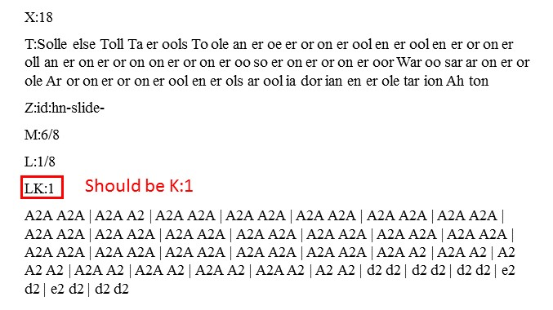
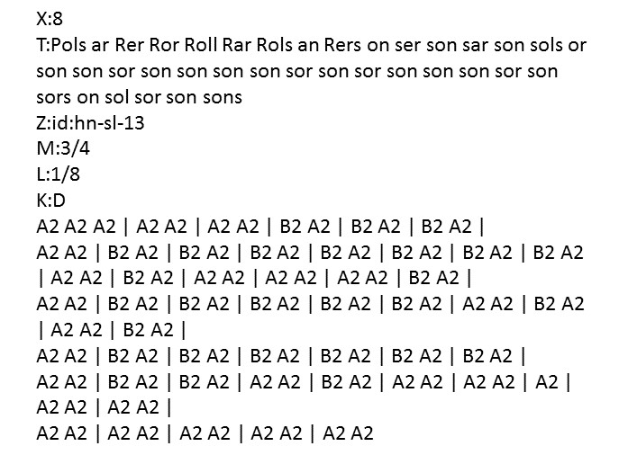
Results
Figure 3: Music generated after 10 epochs with syntax errors
Figure 4: Music generated after 50 epochs with repeated notes

Slide 8
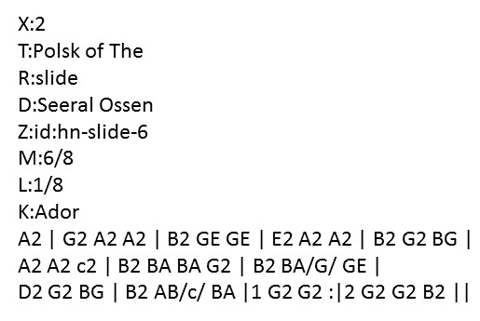
Results cont…
Figure 5: Final music generated after 80 epochs

Slide 9
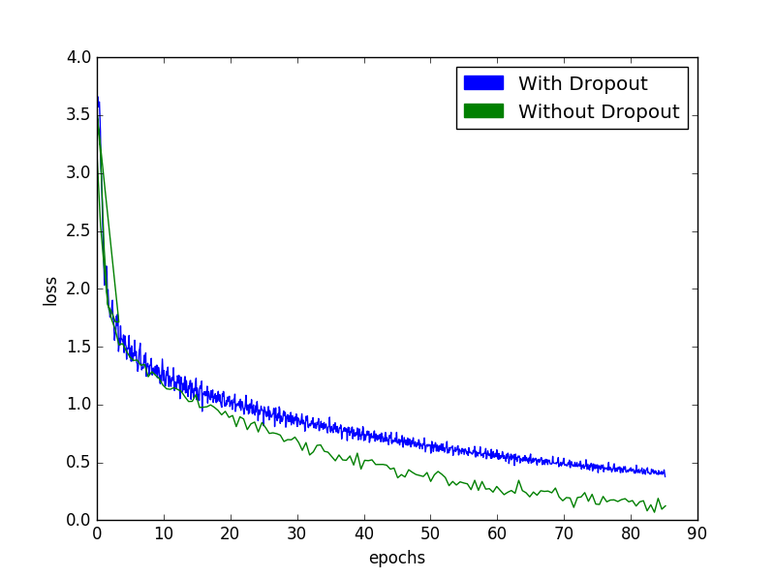
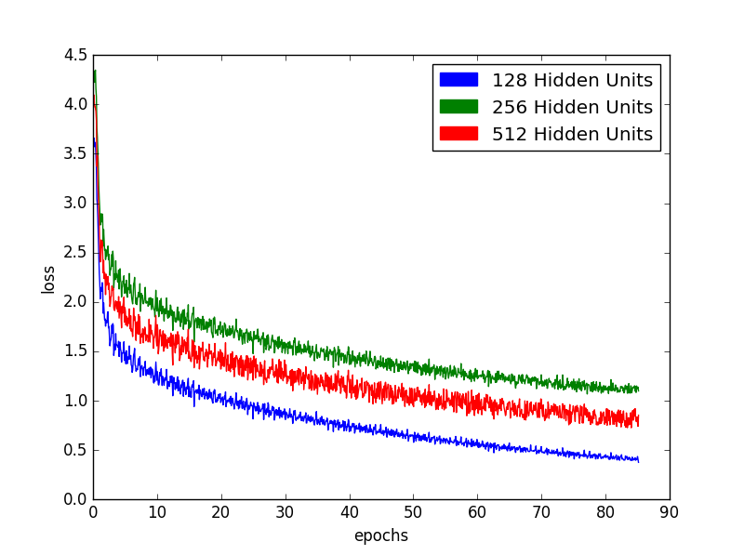
Results cont…
Figure 6: Dropout avoids overfitting
Figure 7: Variation of loss with #hidden units

Slide 10
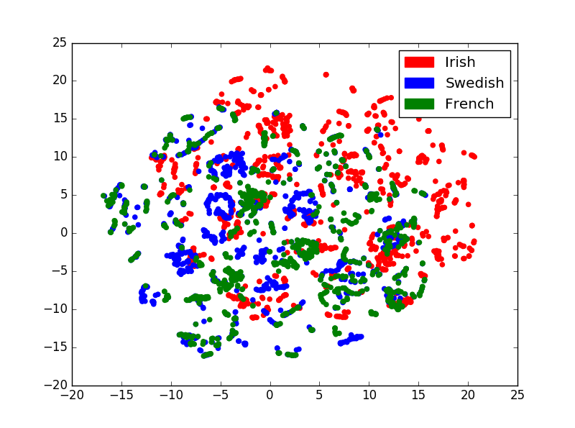
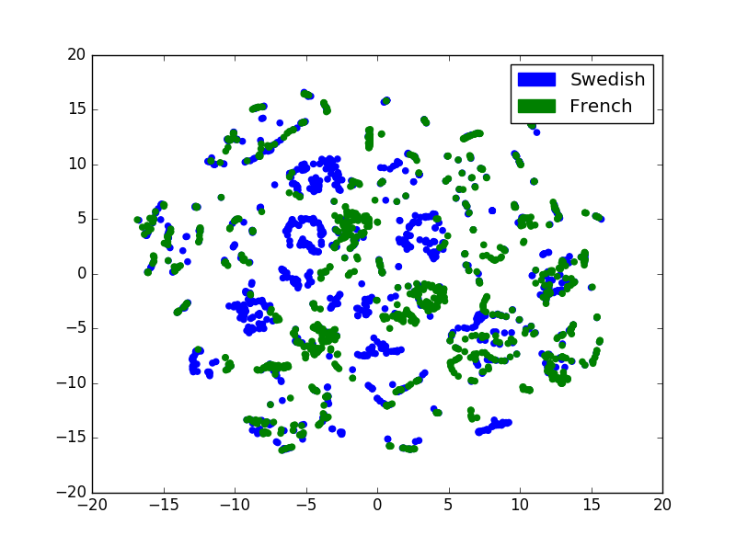
Results cont…
Figure 8: t-SNE plot for all genres
Figure 9: t-SNE plot for Swedish and French tunes

Slide 11
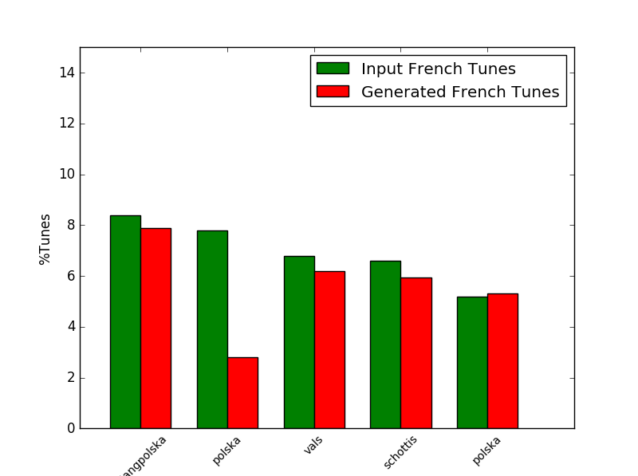
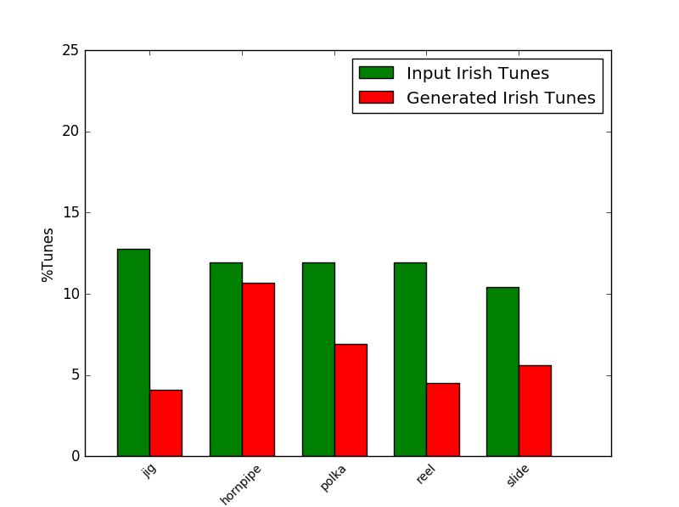
Results cont…
Figure 10: Distribution of top 5 French generated rhythms is same as training
Figure 11: Distribution of top 5 Irish generated rhythms is same as training

Slide 12
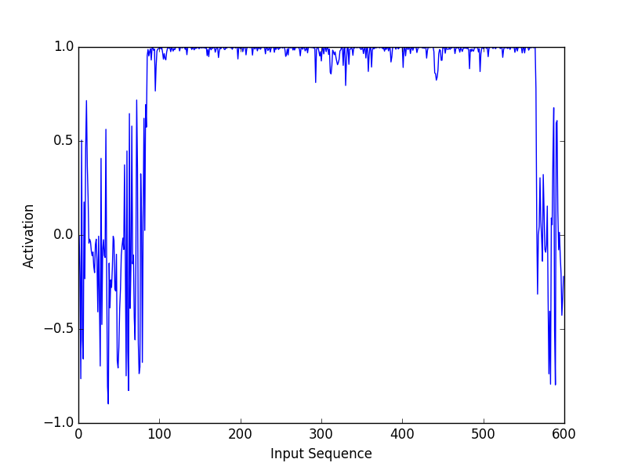
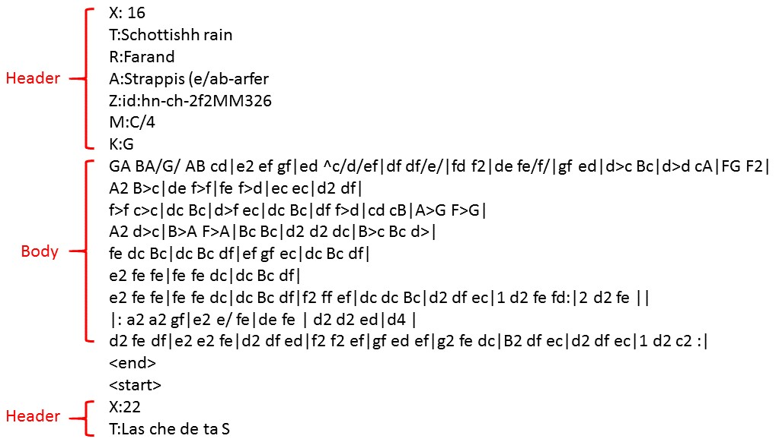
Feature Visualization
Figure 12: Activation of a neuron detecting tune body in the input sequence
Figure 13: Input sequence

Slide 13
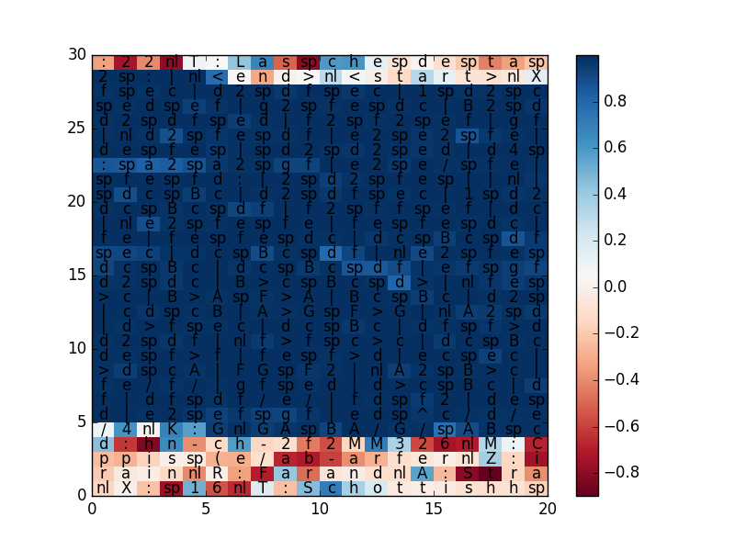
Feature Visualization cont…
Body end
Body start
Figure 14: Activation of a neuron detecting tune body in the input sequence
Figure 15: Input sequence

Slide 14
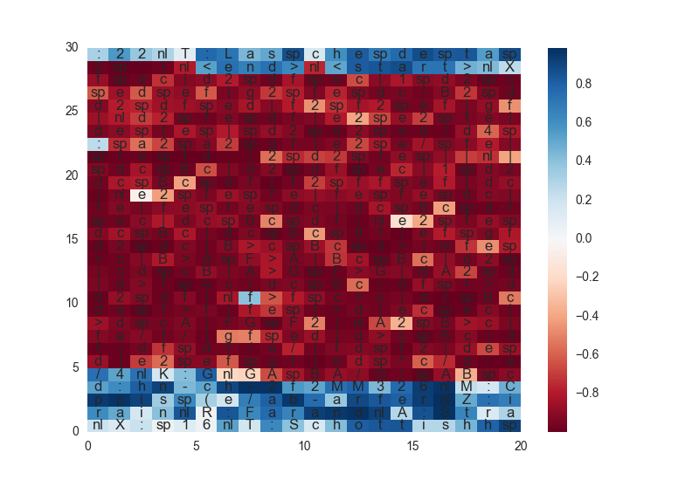
Feature Visualization cont…
Body end
Body start
Figure 16: Activation of a neuron detecting tune header in the input sequence
Figure 17: Input sequence

Slide 15
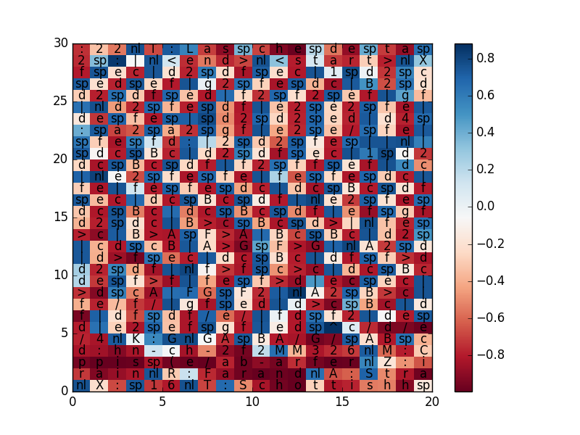
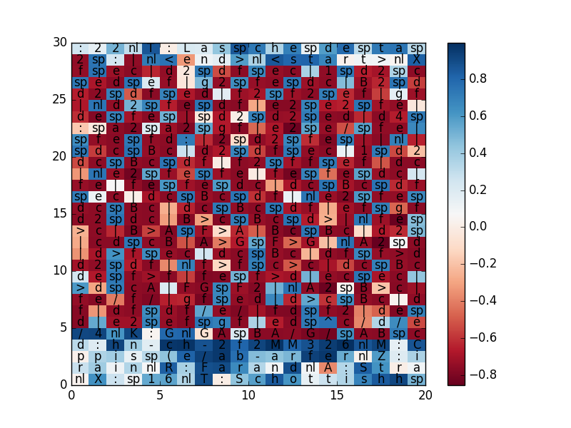
Feature Visualization cont…
Body end
Body end
Body start
Body start
Figure 18: Activation of a neuron detecting spaces, newline and pipe character
Figure 19: Activation of a neuron detecting spaces, newline and pipe character in the body

Slide 16
Demo
http://goo.gl/THHLDy

Slide 17
Summary
Music represented as text in Abc notation
Char level LSTM networks with auxiliary input to generate music compositions
Dropouts used to improve the performance
Results related to music generation based on auxiliary inputs proved through use of t-SNE plots and histograms.
Feature visualization to interpret different features learnt by the network
Live demonstration for project

Slide 18
Q&A
Thanks ☺

